Slide 1
Introduction to CUDA Programming
Scans
Andreas Moshovos
Winter 2009
Based on slides from:
Wen Mei Hwu (UIUC) and David Kirk (NVIDIA)
White Paper/Slides by Mark Harris (NVIDIA)

Slide 2
Scan / Parallel Prefix Sum
3
1
7
0
4
1
6
3
0
3
4
11
11
15
16
22
Given an array A = [a0, a1, …, an-1]
and a binary associative operator @ with identity I
  scan (A) = [I, a0, (a0 @ a1), …, (a0 @ a1 @ … @ an-2)]
This is the exclusive scan ← We’ll focus on this

Slide 3
Inclusive Scan
3
1
7
0
4
1
6
3
3
4
11
11
15
16
22
25
Given an array A = [a0, a1, …, an-1]
and a binary associative operator @ with identity I
  scan (A) = [a0, (a0 @ a1), …, (a0 @ a1 @ … @ an-1)]
This is the inclusive scan

Slide 4
Applications of Scan
Scan is used as a building block for many parallel algorithms
  Radix sort
  Quicksort
  String comparison
  Lexical analysis
  Run-length encoding
  Histograms
  Etc.
See:
  Guy E. Blelloch. “Prefix Sums and Their Applications”. In John H. Reif (Ed.), Synthesis of Parallel Algorithms, Morgan Kaufmann, 1990. http://www.cs.cmu.edu/afs/cs.cmu.edu/project/scandal/public/papers/CMU-CS-90-190.html

Slide 5
Scan Background
Pre-GPU
  First proposed in APL by Iverson (1962)
  Used as a data parallel primitive in the Connection Machine (1990)
    Feature of C* and CM-Lisp
  Guy Blelloch used scan as a primitive for various parallel algorithms
    Blelloch, 1990, “Prefix Sums and Their Applications”
GPU Computing
  O(n log n) work GPU implementation by Daniel Horn (GPU Gems 2)
    Applied to Summed Area Tables by Hensley et al. (EG05)
  O(n) work GPU scan by Sengupta et al. (EDGE06) and Greß et al. (EG06)
  O(n) work & space GPU implementation by Harris et al. (2007)
    NVIDIA CUDA SDK and GPU Gems 3
    Applied to radix sort, stream compaction, and summed area tables

Slide 6
Sequential algorithm
3
1
7
0
4
1
6
3
0
3
4
void scan( float* output, float* input, int length)
{
output[0] = 0; // since this is a prescan, not a scan
for(int j = 1; j < length; ++j)
{
output[j] = input[j-1] + output[j-1];
}
}
N additions
Use a guide:
  Want parallel to be work efficient
  Does similar amount of work

Slide 7
Naïve Parallel Algorithm
for d := 1 to log₂n do
forall k in parallel do
if k >= 2^{d} then x[k] := x[k − 2^{d-1}] + x[k]
3
1
7
0
4
1
6
3
0
3
1
7
0
4
1
6
d = 1, 2^{d -1} = 1
0
3
4
8
7
4
5
7
d = 2, 2^{d -1} = 2
0
3
4
11
11
12
12
11
d = 3, 2^{d -1} = 4
0
3
4
11
11
15
16
22

Slide 8
Need Double-Buffering
First all read
Then all write
Solution
  Use two arrays:
    Input & Output
  Alternate at each step
0
3
4
8
7
4
5
7
0
3
4
11
11
12
12
11

Slide 9
Double Buffering
Two arrays A & B
Input in global memory
Output in global memory
3
1
7
0
4
1
6
3
input
0
3
1
7
0
4
1
6
A
0
3
4
8
7
4
5
7
B
0
3
4
11
11
12
12
11
A
0
3
4
11
11
15
16
22
B
0
3
4
11
11
15
16
22
global

Slide 10
Naïve Kernel in CUDA
__global__ void scan_naive(float *g_odata, float *g_idata, int n)
{
extern __shared__ float temp[];
int thid = threadIdx.x, pout = 0, pin = 1;
temp[pout*n + thid] = (thid > 0) ? g_idata[thid-1] : 0;
for (int dd = 1; dd < n; dd *= 2)
{
pout = 1 - pout; pin = 1 - pout;
int basein = pin * n, baseout = pout * n;
syncthreads();
temp[baseout +thid] = temp[basein +thid];
if (thid >= dd)
temp[baseout +thid] += temp[basein +thid - dd];
}
syncthreads();
g_odata[thid] = temp[baseout +thid];
}

Slide 11
Analysis of naïve kernel
This scan algorithm executes log(n) parallel iterations
  The steps do n-1, n-2, n-4,... n/2 adds each
  Total adds: O(n*log(n))
This scan algorithm is NOT work efficient
  Sequential scan algorithm does n adds

Slide 12
Improving Efficiency
A common parallel algorithms pattern:
Balanced Trees
  Build balanced binary tree on input data and sweep to and from the root
  Tree is conceptual, not an actual data structure
For scan:
  Traverse from leaves to root building partial sums at internal nodes
    Root holds sum of all leaves
  Traverse from root to leaves building the scan from the partial sums
Algorithm originally described by Blelloch (1990)

Slide 13
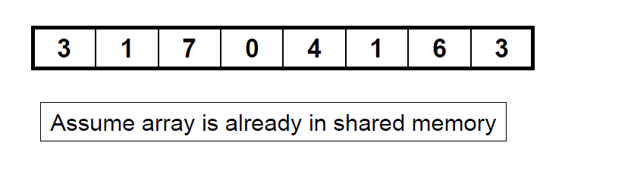
Balanced Tree-Based Scan Algorithm / Up-Sweep

Slide 14
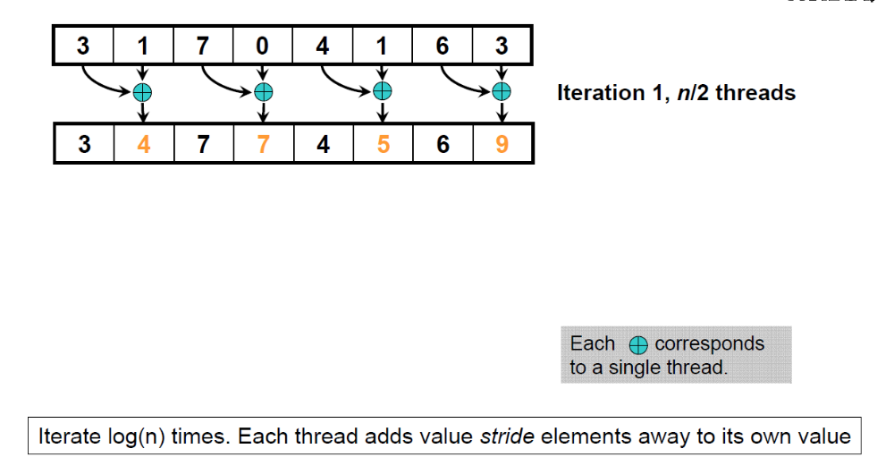
Balanced Tree-Based Scan Algorithm / Up-Sweep

Slide 15
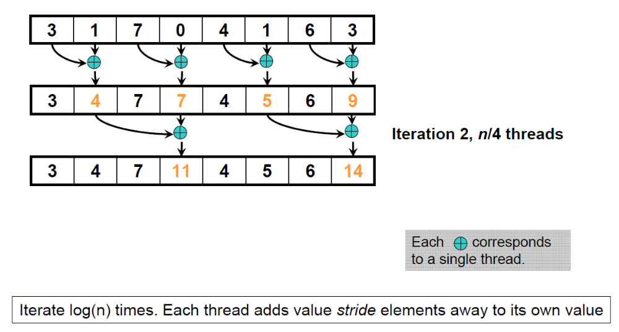
Balanced Tree-Based Scan Algorithm / Up-Sweep

Slide 16
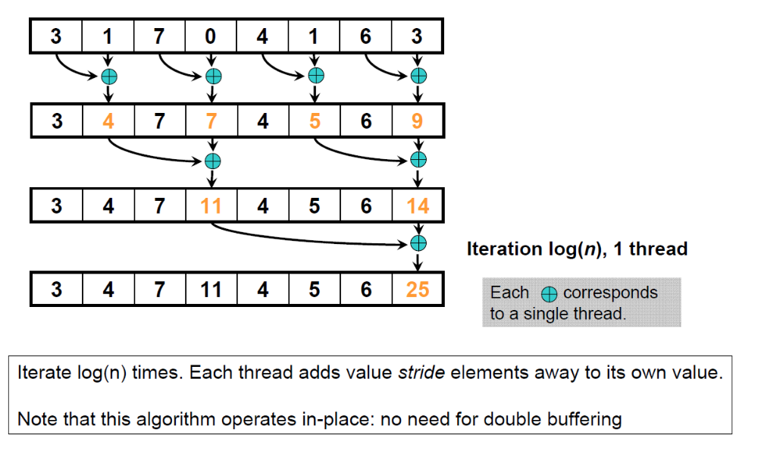
Balanced Tree-Based Scan Algorithm / Up-Sweep

Slide 17
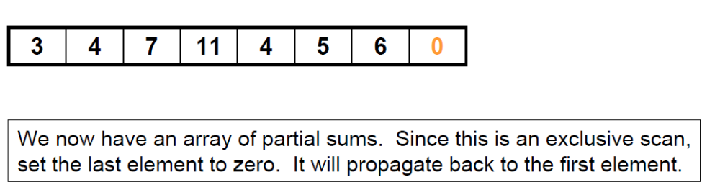
Balanced Tree-Based Scan Algorithm / Up-Sweep

Slide 18
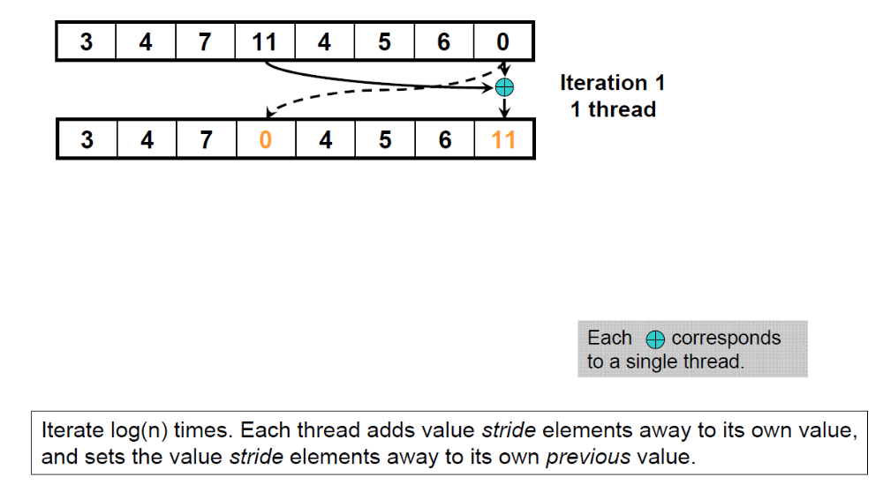
Balanced Tree-Based Scan Algorithm / Down-Sweep

Slide 19
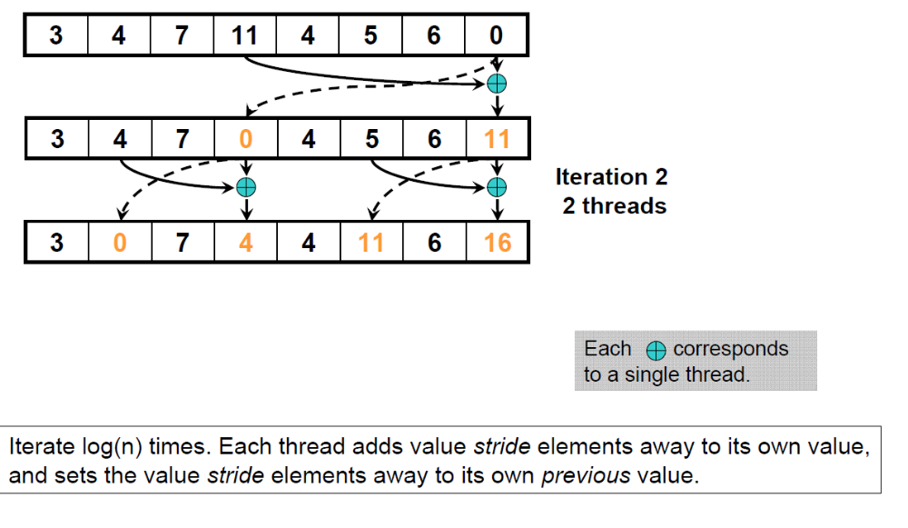
Balanced Tree-Based Scan Algorithm / Down-Sweep

Slide 20
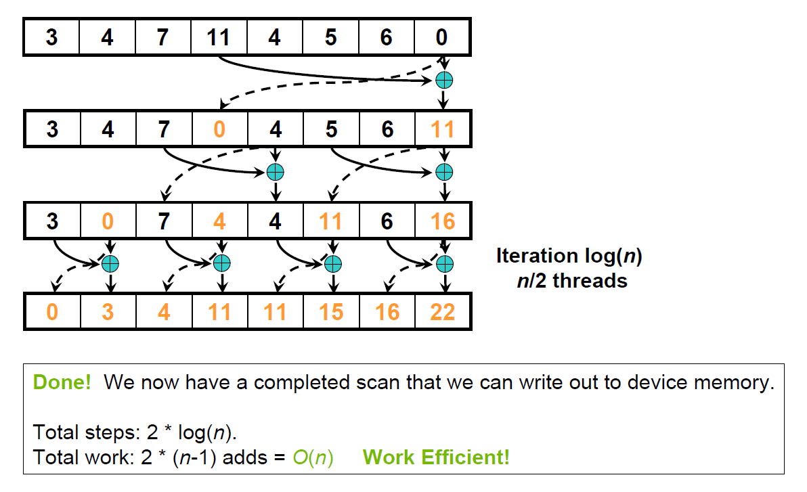
Balanced Tree-Based Scan Algorithm / Down-Sweep

Slide 21
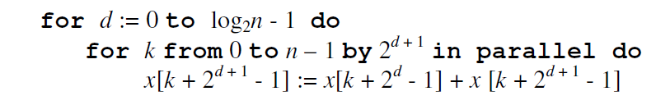
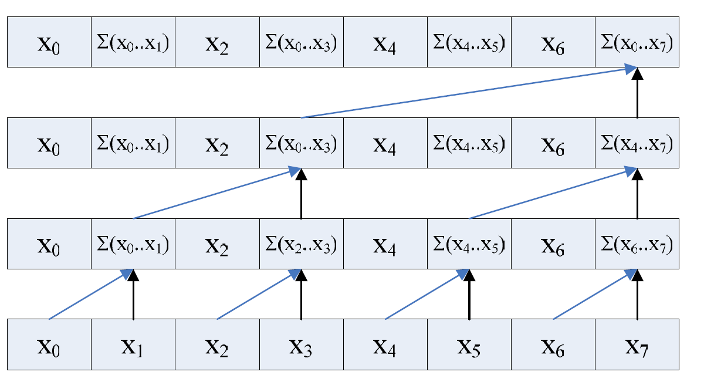
Up-Sweep Pseudo-Code

Slide 22
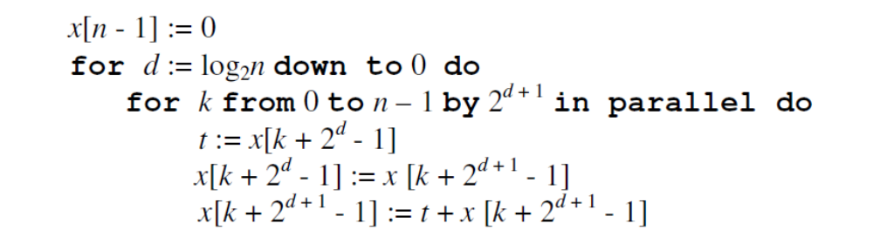
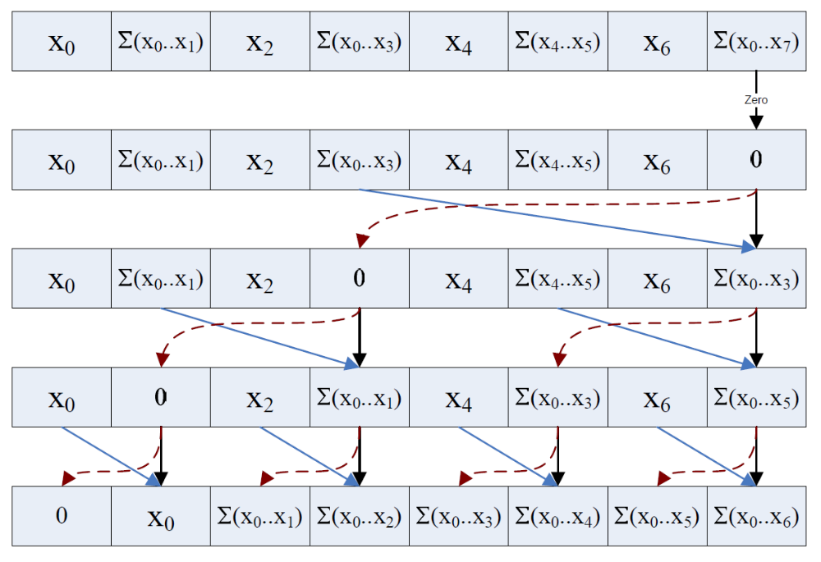
Down-Sweep Pseudo-Code

Slide 23
Cuda Implementation
Declarations & Copying to shared memory
  Two elements per thread
__global__ void prescan(float *g_odata, float *g_idata, int n)
{
extern __shared__ float temp[N];// allocated on invocation
int thid = threadIdx.x;
int offset = 1;
temp[2*thid] = g_idata[2*thid]; // load input into shared memory
temp[2*thid+1] = g_idata[2*thid+1];

Slide 24
Cuda Implementation
Up-Sweep
for (int d = n>>1; d > 0; d >>= 1)
// build sum in place up the tree
{
__syncthreads();
if (thid < d)
{
int ai = offset*(2*thid+1)-1;
int bi = offset*(2*thid+2)-1;
temp[bi] += temp[ai];
}
offset *= 2;
}
Same computation
Different assignment of threads

Slide 25
Up-Sweep: Who does what
t0
t1
t2
t3
t4
t5
t6
t7
d = 8
d = 4
d = 2
d = 1

Slide 26
Up-Sweep: Who does what
For N=16
  ai 0 bi 1 offset 1 d 8 n 16 thid 0
  ai 1 bi 3 offset 2 d 4 n 16 thid 0
  ai 3 bi 7 offset 4 d 2 n 16 thid 0
  ai 7 bi 15 offset 8 d 1 n 16 thid 0
  ai 2 bi 3 offset 1 d 8 n 16 thid 1
  ai 5 bi 7 offset 2 d 4 n 16 thid 1
  ai 11 bi 15 offset 4 d 2 n 16 thid 1
  ai 4 bi 5 offset 1 d 8 n 16 thid 2
  ai 9 bi 11 offset 2 d 4 n 16 thid 2
  ai 6 bi 7 offset 1 d 8 n 16 thid 3
  ai 13 bi 15 offset 2 d 4 n 16 thid 3
  ai 8 bi 9 offset 1 d 8 n 16 thid 4
  ai 10 bi 11 offset 1 d 8 n 16 thid 5
  ai 12 bi 13 offset 1 d 8 n 16 thid 6
  ai 14 bi 15 offset 1 d 8 n 16 thid 7

Slide 27
Down-Sweep
// clear the last element
if (thid == 0) { temp[n - 1] = 0; }
// traverse down tree & build scan
for (int d = 1; d < n; d *= 2)
{
offset >>= 1;
__syncthreads();
if (thid < d)
{
int ai = offset*(2*thid+1)-1;
int bi = offset*(2*thid+2)-1;
float t = temp[ai];
temp[ai] = temp[bi];
temp[bi] += t;
}
}
__syncthreads()

Slide 28
Down-Sweep: Who does what
N = 32
  ai 7 bi 15 offset 8 d 1 n 16 thid 0
  ai 3 bi 7 offset 4 d 2 n 16 thid 0
  ai 1 bi 3 offset 2 d 4 n 16 thid 0
  ai 0 bi 1 offset 1 d 8 n 16 thid 0
  ai 11 bi 15 offset 4 d 2 n 16 thid 1
  ai 5 bi 7 offset 2 d 4 n 16 thid 1
  ai 2 bi 3 offset 1 d 8 n 16 thid 1
  ai 9 bi 11 offset 2 d 4 n 16 thid 2
  ai 4 bi 5 offset 1 d 8 n 16 thid 2
  ai 13 bi 15 offset 2 d 4 n 16 thid 3
  ai 6 bi 7 offset 1 d 8 n 16 thid 3
  ai 8 bi 9 offset 1 d 8 n 16 thid 4
  ai 10 bi 11 offset 1 d 8 n 16 thid 5
  ai 12 bi 13 offset 1 d 8 n 16 thid 6
  ai 14 bi 15 offset 1 d 8 n 16 thid 7

Slide 29
Copy to output
All threads do:
__syncthreads();
// write results to global memory
g_odata[2*thid] = temp[2*thid];
g_odata[2*thid+1] = temp[2*thid+1];
}

Slide 30
Bank Conflicts
Current scan implementation has many shared memory bank conflicts
  These really hurt performance on hardware
Occur when multiple threads access the same shared memory bank with different addresses
No penalty if all threads access different banks
  Or if all threads access exact same address
Access costs 2*M cycles if there is a conflict
  Where M is max number of threads accessing single bank

Slide 31
Loading from Global Memory to Shared
Each thread loads two shared mem data elements
Original code interleaves loads:
  temp[2*thid] = g_idata[2*thid];
  temp[2*thid+1] = g_idata[2*thid+1];
Threads:(0,1,2,…,8,9,10,…)→
  banks:(0,2,4,…,0,2,4,…)
Better to load one element from each half of the array
  temp[thid] = g_idata[thid];
  temp[thid + (n/2)] = g_idata[thid + (n/2)];

Slide 32
Bank Conflicts in the Tree Algorithm / Up-Sweep
When we build the sums, each thread reads two shared memory locations and writes one:
  Threads 0 and 8 access bank 0
t0
t1
t2
t3
t4
t5
t6
t7
t8
t9
Bank:
0 | 1 | 2 | 3 | 4 | 5 | 6 | 7 | 8 | 9 | 10 | 11 | 12 | 13 | 14 | 15 | 0 | 1 | 2 | ...
3 | 1 | 7 | 0 | 4 | 1 | 6 | 3 | 5 | 8 | 2 | 0 | 3 | 3 | 1 | 9 | 4 | 5 | 7 | …
…
0 | 1 | 2 | 3 | 4 | 5 | 6 | 7 | 8 | 9 | 10 | 11 | 12 | 13 | 14 | 15 | 0 | 1 | 2 | ...
3 | 4 | 7 | 7 | 4 | 5 | 6 | 9 | 5 | 13 | 2 | 2 | 3 | 6 | 1 | 10 | 4 | 9 | 7 | …
First iteration: 2 threads access each of 8 banks.
Each corresponds to a single thread.
Like-colored arrows represent simultaneous memory accesses

Slide 33
Bank Conflicts in the Tree Algorithm / Up-Sweep
When we build the sums, each thread reads two shared memory locations and writes one:
  Threads 1 and 9 access bank 2, and so on
t0
t1
t2
t3
t4
t5
t6
t7
t8
t9
Bank:
0 | 1 | 2 | 3 | 4 | 5 | 6 | 7 | 8 | 9 | 10 | 11 | 12 | 13 | 14 | 15 | 0 | 1 | 2 | ...
3 | 1 | 7 | 0 | 4 | 1 | 6 | 3 | 5 | 8 | 2 | 0 | 3 | 3 | 1 | 9 | 4 | 5 | 7 | …
…
0 | 1 | 2 | 3 | 4 | 5 | 6 | 7 | 8 | 9 | 10 | 11 | 12 | 13 | 14 | 15 | 0 | 1 | 2 | ...
3 | 4 | 7 | 7 | 4 | 5 | 6 | 9 | 5 | 13 | 2 | 2 | 3 | 6 | 1 | 10 | 4 | 9 | 7 | …
First iteration: 2 threads access each of 8 banks.
Each corresponds to a single thread.
Like-colored arrows represent simultaneous memory accesses

Slide 34
Bank Conflicts in the Tree Algorithm / Down-Sweep
2nd iteration: even worse
  4-way bank conflicts; for example:
  Threads 0,4,8,12, access bank 1, Threads 1,5,9,13, access Bank 5, etc.
t0
t1
t2
t3
t4
Bank:
0 | 1 | 2 | 3 | 4 | 5 | 6 | 7 | 8 | 9 | 10 | 11 | 12 | 13 | 14 | 15 | 0 | 1 | 2 | ...
3 | 4 | 7 | 4 | 4 | 5 | 6 | 9 | 5 | 13 | 2 | 2 | 3 | 6 | 1 | 10 | 4 | 9 | 7 | …
…
0 | 1 | 2 | 3 | 4 | 5 | 6 | 7 | 8 | 9 | 10 | 11 | 12 | 13 | 14 | 15 | 0 | 1 | 2 | ...
3 | 4 | 7 | 11 | 4 | 5 | 6 | 14 | 5 | 13 | 2 | 15 | 3 | 6 | 1 | 16 | 4 | 9 | 7 | …
2nd iteration: 4 threads access each of 4 banks.
Each corresponds to a single thread.
Like-colored arrows represent simultaneous memory accesses

Slide 35
Using Padding to Prevent Conflicts
We can use padding to prevent bank conflicts
  Just add a word of padding every 16 words:
Bank:
0 | 1 | 2 | 3 | 4 | 5 | 6 | 7 | 8 | 9 | 10 | 11 | 12 | 13 | 14 | 15 | 0 | 1 | 2 | 3 | …
3 | 1 | 7 | 0 | 4 | 1 | 6 | 3 | 5 | 8 | 2 | 0 | 3 | 3 | 1 | 9 | P | 4 | 5 | 7 | …
…
0 | 1 | 2 | 3 | 4 | 5 | 6 | 7 | 8 | 9 | 10 | 11 | 12 | 13 | 14 | 15 | 0 | 1 | 2 | 3 | ...
3 | 4 | 7 | 7 | 4 | 5 | 6 | 9 | 5 | 13 | 2 | 2 | 3 | 6 | 1 | 10 | P | 4 | 9 | 7 | …
In time:

Slide 36
Using Padding to Remove Conflicts
After you compute a shared mem address like this:
  Address = 2 * stride * thid;
Add padding like this:
Address += (address / 16);
(address >> 4)
This removes most bank conflicts
  Not all, in the case of deep trees

Slide 37
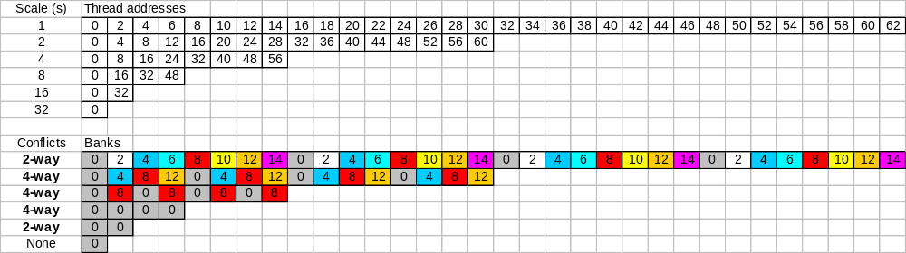
Scan Bank Conflicts (1)
A full binary tree with 64 leaf nodes:
Multiple 2-and 4-way bank conflicts
Shared memory cost for whole tree
  1 32-thread warp = 6 cycles per thread w/o conflicts
    Counting 2 shared mem reads and one write (s[a] += s[b])
  6 * (2+4+4+4+2+1) = 102 cycles
  36 cycles if there were no bank conflicts (6 * 6)

Slide 38
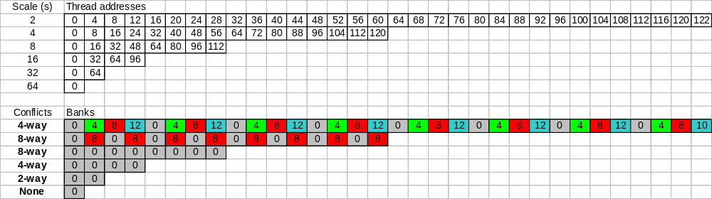
Scan Bank Conflicts (2)
It’s much worse with bigger trees
A full binary tree with 128 leaf nodes
  Only the last 6 iterations shown (root and 5 levels below)
Cost for whole tree:
  12*2 + 6*(4+8+8+4+2+1) = 186 cycles
  48 cycles if there were no bank conflicts: 12*1 + (6*6)

Slide 39
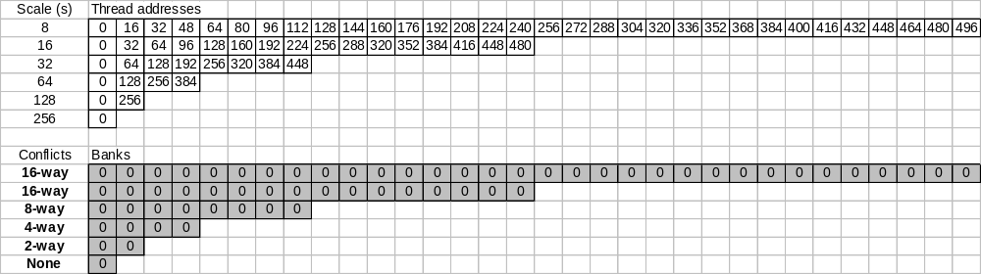
Scan Bank Conflicts (3)
A full binary tree with 512 leaf nodes
  Only the last 6 iterations shown (root and 5 levels below)
Cost for whole tree:
  48*2+24*4+12*8+6* (16+16+8+4+2+1) = 570 cycles
  120 cycles if there were no bank conflicts!

Slide 40
Fixing Scan Bank Conflicts
Insert padding every NUM_BANKS elements
  const int LOG_NUM_BANKS = 4; // 16 banks
  int tid = threadIdx.x;
  int s = 1;
  // Traversal from leaves up to root
  for (d = n>>1; d > 0; d >>= 1)
  {
  if (thid <= d)
  {
  int a = s*(2*tid); int b = s*(2*tid+1)
  a += (a >> LOG_NUM_BANKS); // insert pad word
  b += (b >> LOG_NUM_BANKS); // insert pad word
  shared[a] += shared[b];
  }
  }

Slide 41
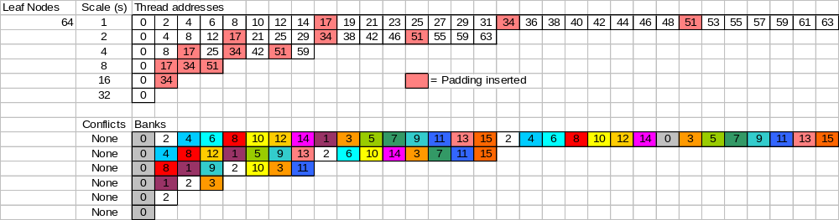
Fixing Scan Bank Conflicts
A full binary tree with 64 leaf nodes
No more bank conflicts
  However, there are ~8 cycles overhead for addressing
    For each s[a] += s[b] (8 cycles/iter. * 6 iter. = 48 extra cycles)
  So just barely worth the overhead on a small tree
    84 cycles vs. 102 with conflicts vs. 36 optimal
Notes:
2 shifts and 2 adds per address computation. At 2 cycles each for a 32-thread warp, that’s 8 cycles overhead, plus the 6 cycles for the s[a] += s[b] without bank conflicts. So
(6+8)*6 = 84 cycles

Slide 42
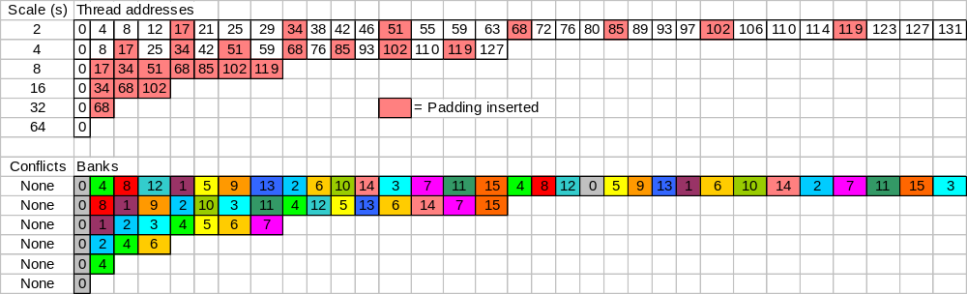
Fixing Scan Bank Conflicts
A full binary tree with 128 leaf nodes
  Only the last 6 iterations shown (root and 5 levels below)
No more bank conflicts!
  Significant performance win:
    106 cycles vs. 186 with bank conflicts vs. 48 optimal
Notes:
1 shift and 1 add per address computation. At 2 cycles each for a 32-thread warp, that’s 8 cycles overhead, plus the 6 cycles for the s[a] += s[b] without bank conflicts. So
(6+8)*7 = 98 cycles

Slide 43
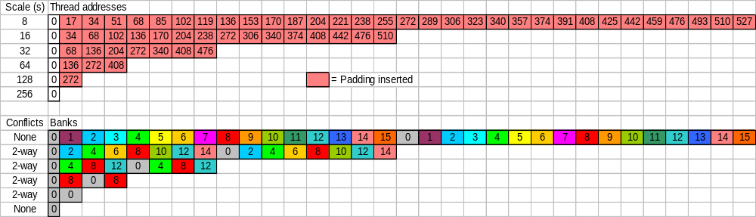
Fixing Scan Bank Conflicts
A full binary tree with 512 leaf nodes
  Only the last 6 iterations shown (root and 5 levels below)
Wait, we still have bank conflicts
  Method is not foolproof, but still much improved
  304 cycles vs. 570 with bank conflicts vs. 120 optimal
Notes:
1 shift and 1 add per address computation. At 2 cycles each for a 32-thread warp, that’s 8 cycles overhead plus the 6 cycles for the s[a] += s[b] without bank conflicts.
But we still have 2-way bank conflicts on 4 tree levels (out of 9 total). So…
(6+8)*5 + (12+8)*4= 150 cycles

Slide 44
Fixing Scan Bank Conflicts
It’s possible to remove all bank conflicts
  Just do multi-level padding
  Example: two-level padding:
  const int LOG_NUM_BANKS = 4; // 16 banks on G80
  int tid = threadIdx.x;
  int s = 1;
  // Traversal from leaves up to root
  for (d = n>>1; d > 0; d >>= 1)
  {
  if (thid <= d)
  {
  int a = s*(2*tid); int b = s*(2*tid+1)
  int offset = (a >> LOG_NUM_BANKS); // first level
  a += offset + (offset >>LOG_NUM_BANKS); // second level
  offset = (b >> LOG_NUM_BANKS); // first level
  b += offset + (offset >>LOG_NUM_BANKS); // second level
  temp[a] += temp[b];
  }
  }
Notes:
A and b calculation so that both offset and offset>>LOG_NUM_BANKS are added to them.

Slide 45
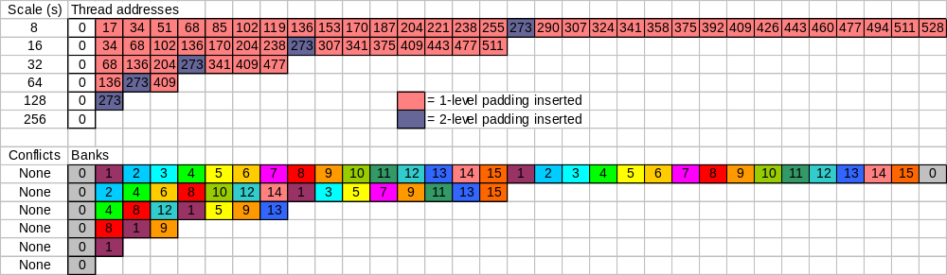
Fixing Scan Bank Conflicts
A full binary tree with 512 leaf nodes
  Only the last 6 iterations shown (root and 5 levels below)
  No bank conflicts
    But an extra cycle overhead per address calculation
    Not worth it: 440 cycles vs. 304 with 1-level padding
  With 1-level padding, bank conflicts only occur in warp 0
    Very small remaining cost due to bank conflicts
    Removing them hurts all other warps
Notes:
2 shifts and 1 add per address computation. At 2 cycles each for a 32-thread warp, that’s 12 cycles overhead, plus the 6 cycles for the s[a] += s[b] without bank conflicts.
(6+12)*9 = 162 cycles

Slide 46
Large Arrays
So far:
  Array can be processed by a block
    1024 elements
Larger arrays?
  Divide into blocks
  Scan each with a block of threads
  Produce partial scans
  Scan the partial scans
  Add the corresponding scan result back to all elements of each block
See Scan Large Array in SDK

Slide 47
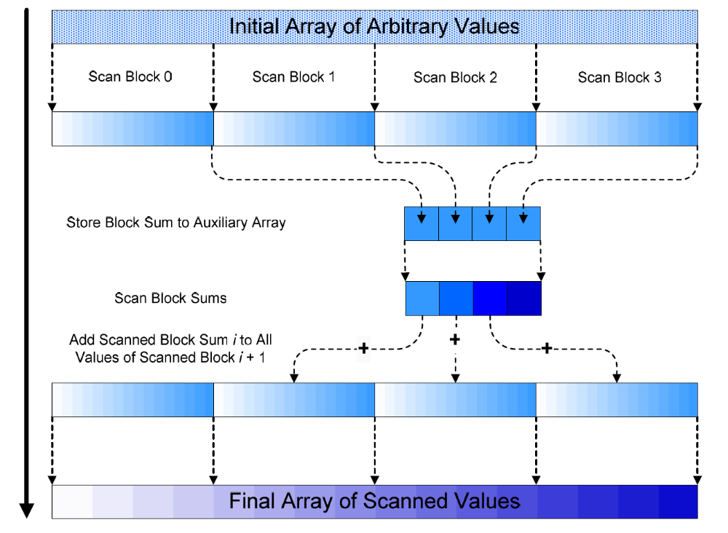
Large Arrays

Slide 48
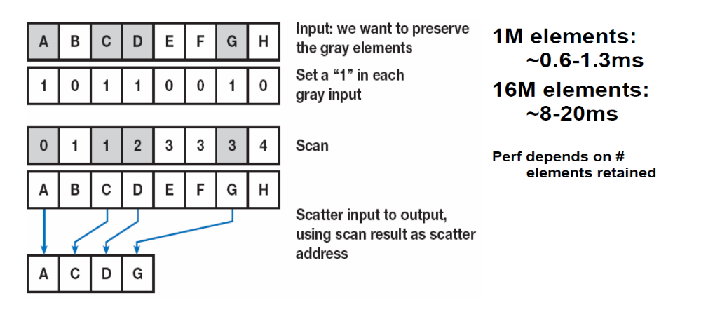
Application: Stream Compaction

Slide 49
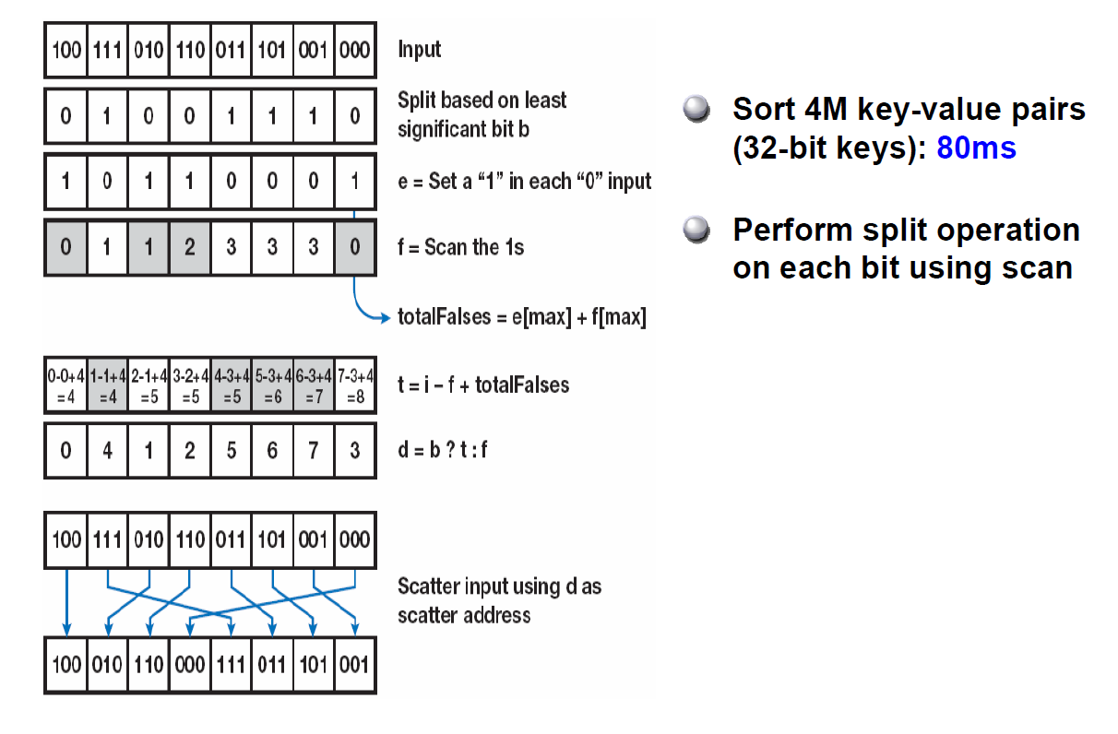
Application: Radix Sort

Slide 50
Using Streams to Overlap Kernels with Data Transfers
Stream:
  Queue of ordered CUDA requests
By default all CUDA request go to the same stream
Create a stream:
  cudaStreamCreate (cudaStream *stream)

Slide 51
Overlapping Kernels
cudaMemcpyAsync (dA, hA, sizeB, cudaMemcpyHostToDevice, streamA);
cudaMemcpyAsync (dB, hB, sizeB, cudaMemcpyHostToDevice, streamB);
Kernel<<<100, 512, 0, streamA>>> (dAo, dA, sizeA);
Kernel<<<100, 512, 0, streamB>>> (dBo, dB, sizeB);
cudaMemcpyAsync(hBo, dAo, cudaMemcpyDeviceToHost, streamA);
cudaMemcpyAsync(hBo, dAo, cudaMemcpyDeviceToHost, streamB);
cudaThreadSynchronize();

